Slide 1
Data Aggregation
Data aggregation is the process of collecting data and presenting it in a summarized manner. Accuracy of data analysis and result delivery depends on the amount and quality of collected data
Data aggregation is used to provide statistical analysis for collated research data and to create a summarized data. The collation, curation, and presentation of data in summary format has been a recognized practice in the commercial world for decades now.

Slide 2
Common Data Aggregation Techniques:
Sum: Add up the values of a group of data points.
Mean: Find the average of the data points.
Median: Identify the middle value in a sorted group.
Count: Count the number of occurrences in a dataset.
Min/Max: Find the smallest or largest value in a group.

Slide 3
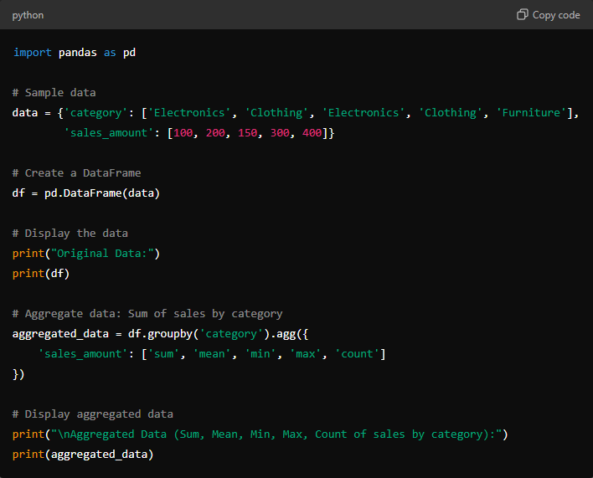

Slide 4
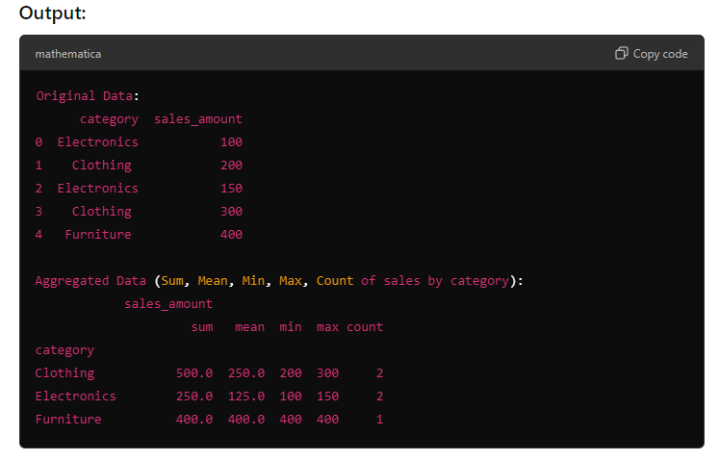

Slide 5
Real-life Example: Sales Data Aggregation
Imagine a scenario where you manage a retail store, and you want to analyze the total and average sales for different product categories over a period of time.
For example, let’s say we have sales data from different stores, and we want to know:
The total sales of each category.
The average sales per transaction.
The number of transactions for each category.

Slide 6
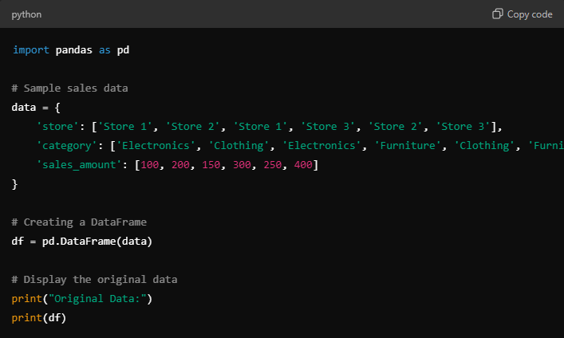
Step 1: Create Sample Data
Here’s a simple dataset of sales transactions from a retail store, with category, store, and sales_amount.

Slide 7
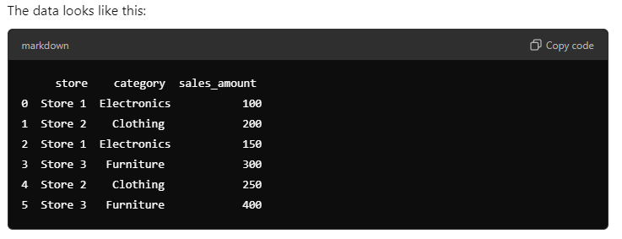

Slide 8
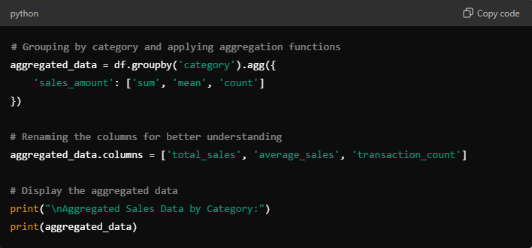
Step 2: Perform Data Aggregation
Now, let's group the data by category to find:
Total sales (sum of sales_amount).
Average sales (mean of sales_amount).
Number of transactions (count of sales_amount).

Slide 9
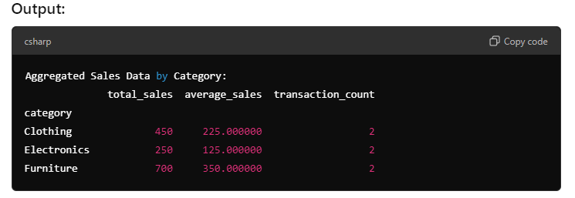

Slide 10
Explanation:
Clothing:
Total Sales: 450 (sum of all sales transactions in the Clothing category).
Average Sales per Transaction: 225.
Transaction Count: There were 2 transactions for Clothing.
Electronics:
Total Sales: 250.
Average Sales per Transaction: 125.
Transaction Count: 2 transactions.
Furniture:
Total Sales: 700.
Average Sales per Transaction: 350.
Transaction Count: 2 transactions.

Slide 11
Conclusion:
In this real-life retail example, we used data aggregation techniques to summarize sales data by product category. This gives store managers useful insights:
How much was sold in each category (total sales).
What was the average transaction size (average sales).
How many transactions occurred in each category (transaction count).

